Slide 1

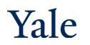
Deep Learning Theory and Applications CNNs
CPSC/AMTH 452/552
CBB 663

Slide 2
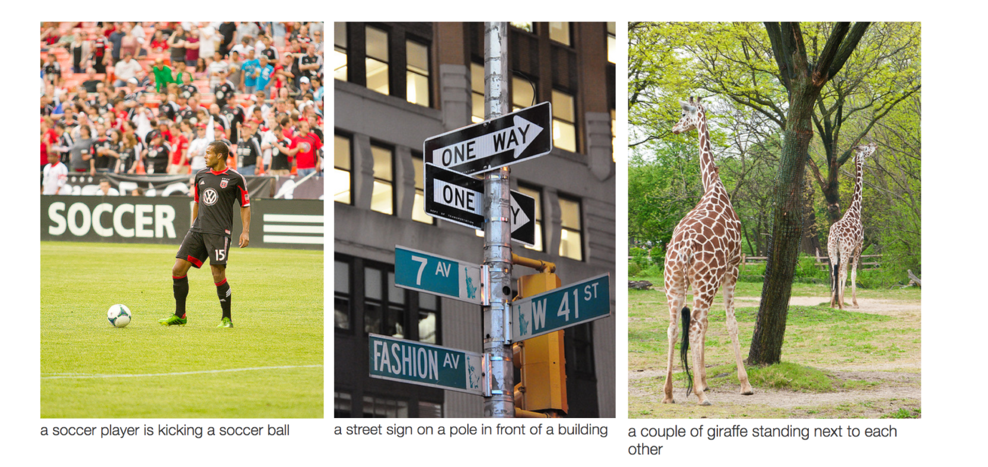
Taking An Image as an Input
Nnets have been very good at classifying real world images
First architecture was LeNet formulated by Yann Lecun in 1988

Slide 3
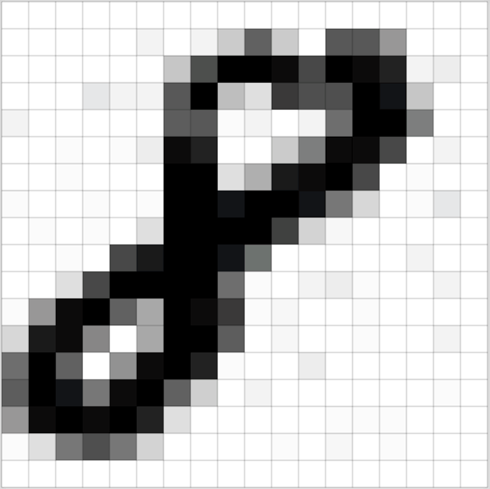
Images are a series of Pixel Values
Grayscale images:
0=Black
255 = White
Spatial locality structure

Slide 4
CNNs use three basic ideas
Local receptive fields
Shared weights
Pooling

Slide 5

Local receptive fields
Standard Neural Network (all nodes are connected, input is a vector)
Image taken from Michael Neilsen’s book “Neural Networks and Deep Learning”

Slide 6
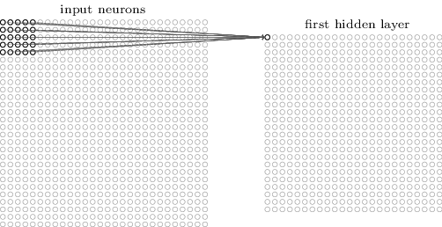
Local receptive fields
Make connections in small, localized regions of the input image
Image taken from Michael Neilsen’s book “Neural Networks and Deep Learning”

Slide 7
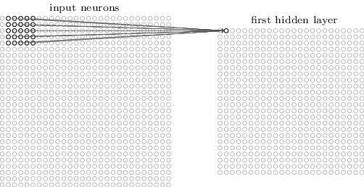
Local receptive fields
Slide the local receptive field over by one (or more) pixel and repeat
Image taken from Michael Neilsen’s book “Neural Networks and Deep Learning”

Slide 8
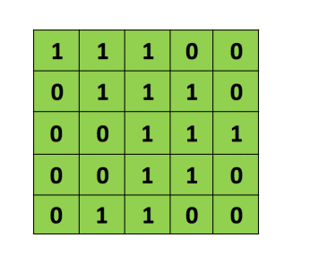
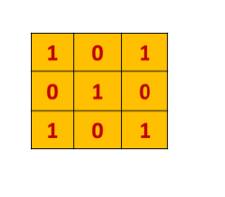

The convolution operation
Filter/
Feature detector
Pointwise multiply
Add results
Translate filter
Image

Slide 9

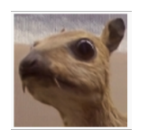
Filters
Original Image

Slide 10
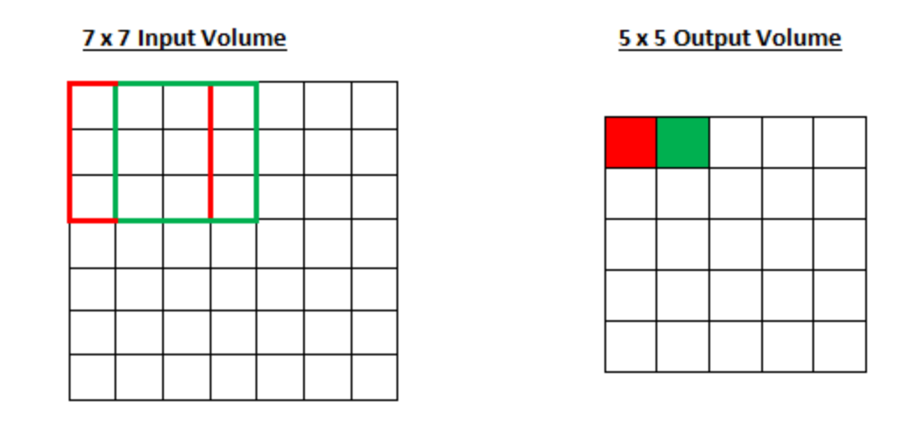
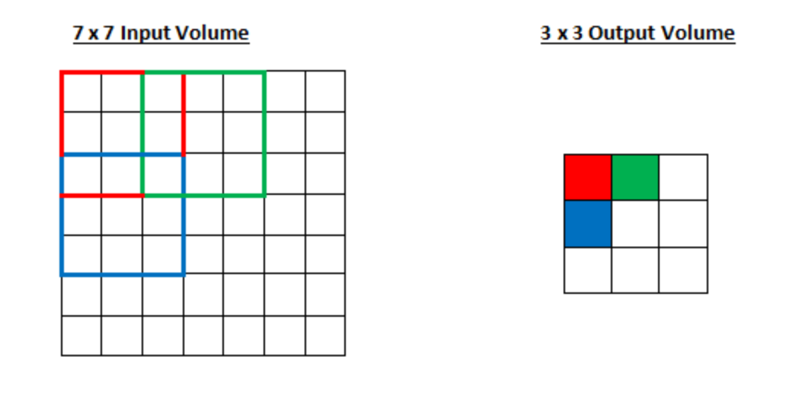
Stride
Stride 1
Stride 2

Slide 11
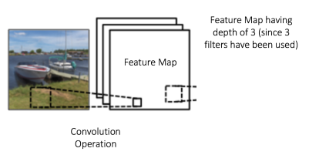
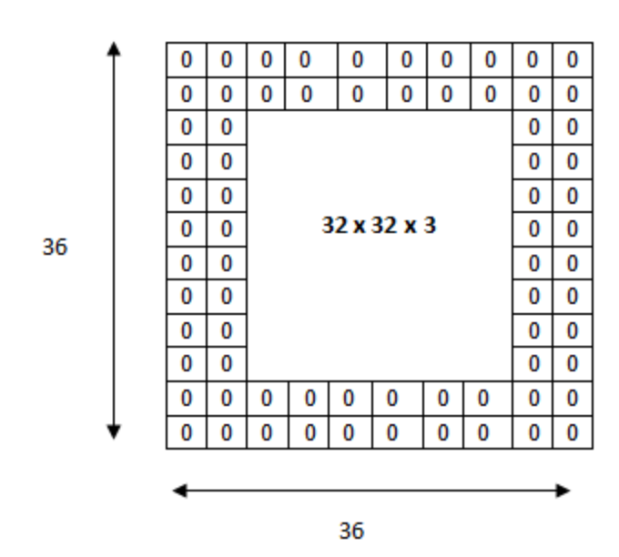
Depth and Zero Padding
Depth
Padding

Slide 12
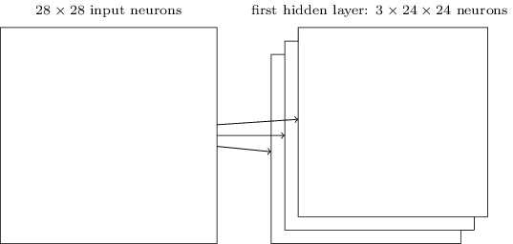
Shared weights and biases
A single layer in a CNN includes multiple feature maps
Image taken from Michael Neilsen’s book “Neural Networks and Deep Learning”

Slide 13
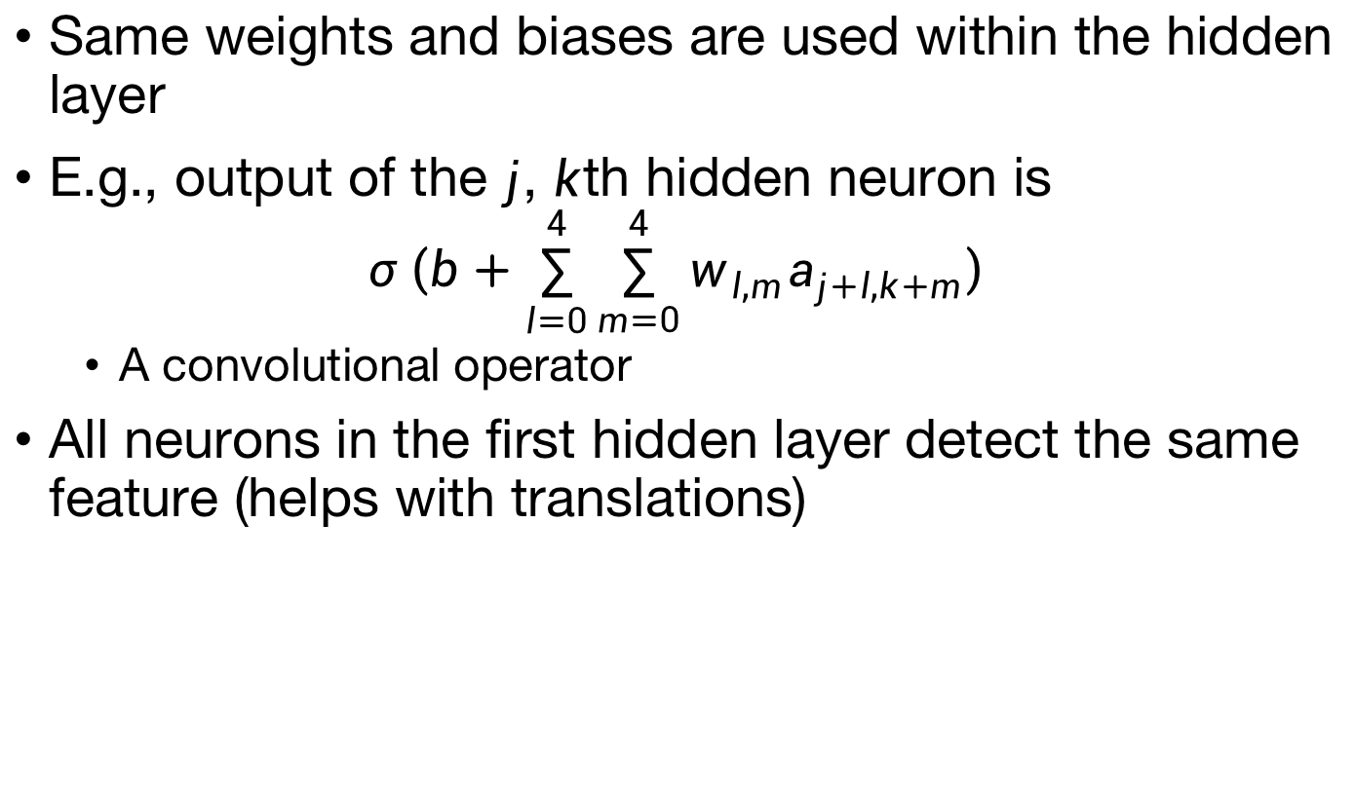
Shared weights and biases
Same weights and biases are used within the hidden layer
E.g., output of the $j$, $k$th hidden neuron is
$$σ\left(b+\sum_{l=0}^{4}{\sum_{m=0}^{4}{w_{l,m}a_{j+l,k+m}}}\right)$$
A convolutional operator
All neurons in the first hidden layer detect the same feature (helps with translations)

Slide 14
Shared weights and biases
Why use shared weights?
Greatly reduces the number of parameters (faster training)
MNIST Example
CNN layer with 20 feature maps: 520 parameters
Fully connected neural net with 30 hidden neurons: 23,550 parameters

Slide 15
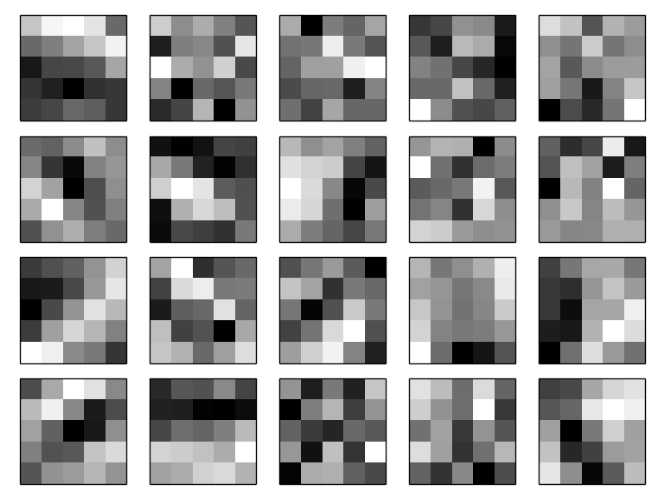
Shared weights and biases
Some example filters when trained on MNIST
Image taken from Michael Neilsen’s book “Neural Networks and Deep Learning”

Slide 16
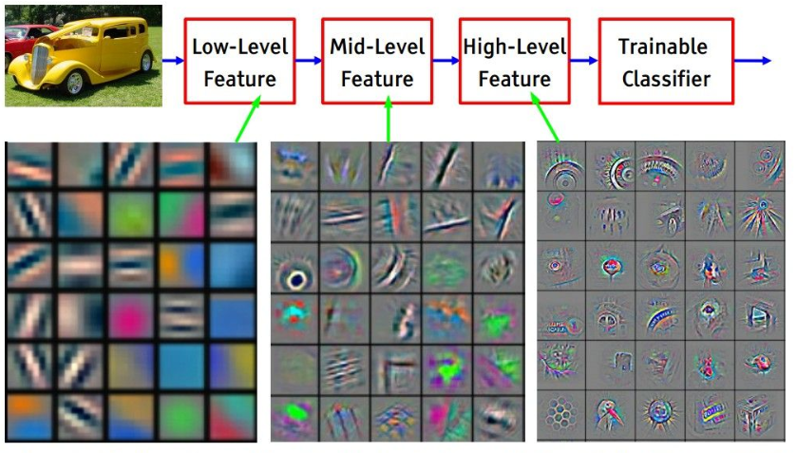
filter at layer of different depth learn different level of features
filter at shallow-layer
filter at middle-layer
filter at deep-layer

Slide 17
Pooling layers
Usually used immediately after convolutional layers
Used to simplify the output from the convolutional layer
E.g., max-pooling outputs the maximum activation in a region

Slide 18
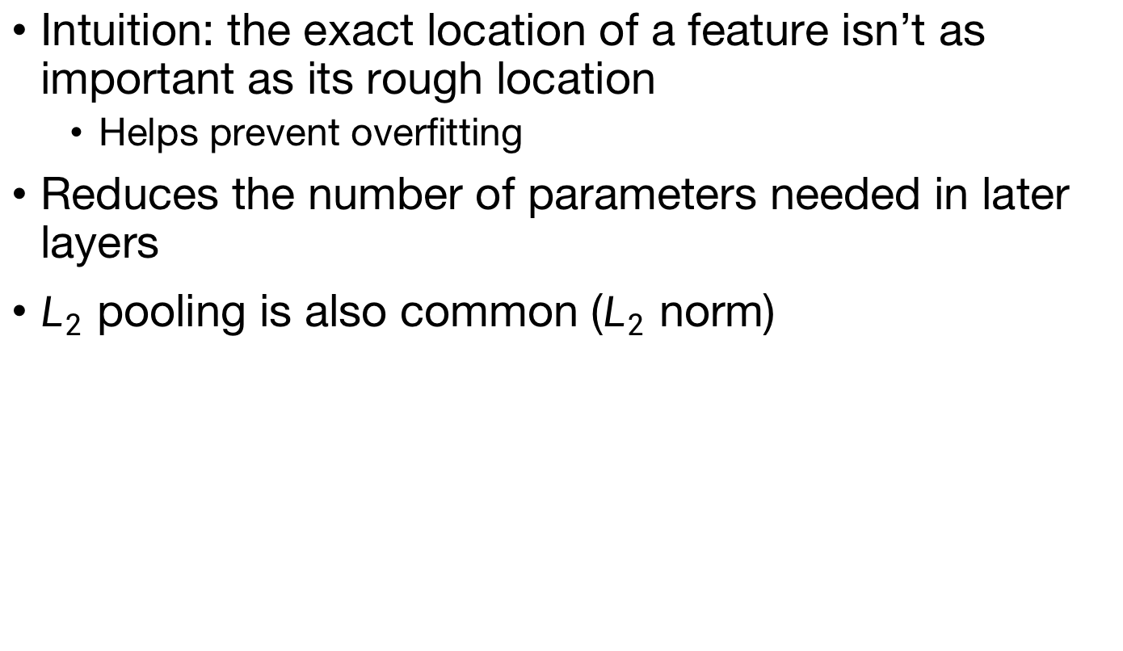
Pooling layers
Intuition: the exact location of a feature isn’t as important as its rough location
Helps prevent overfitting
Reduces the number of parameters needed in later layers
$L_{2}$ pooling is also common ($L_{2}$ norm)

Slide 19
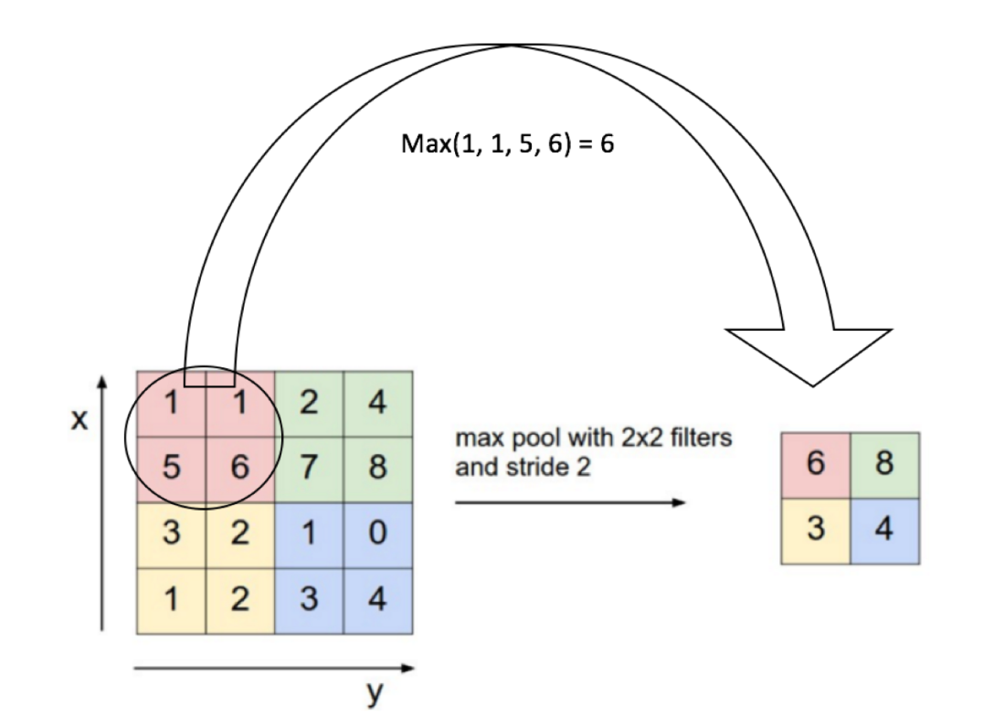
Pooling
Downsampling the results by pooling values by averaging or max
Max pool is used more commonly

Slide 20
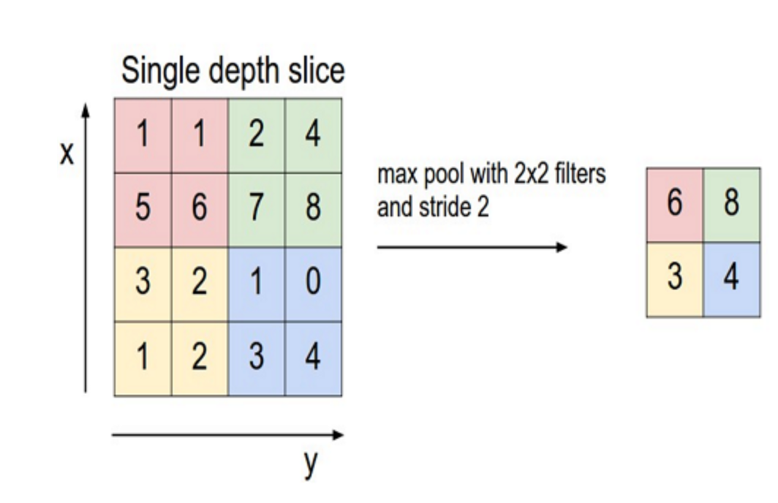

Slide 21
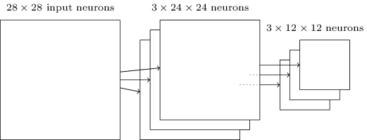
Pooling layers
Pooling applied to multiple feature maps
Image taken from Michael Neilsen’s book “Neural Networks and Deep Learning”

Slide 22
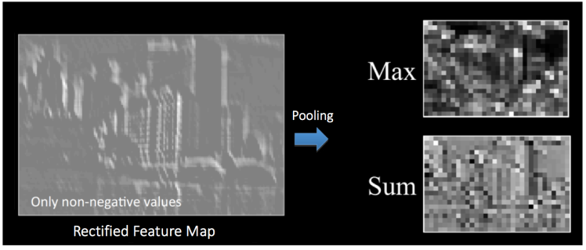
Other Effects of Pooling
Reducing spatial size of the image
Making CNNs invariant to distortions and noise
Reduces parameters
Scale invariance

Slide 23
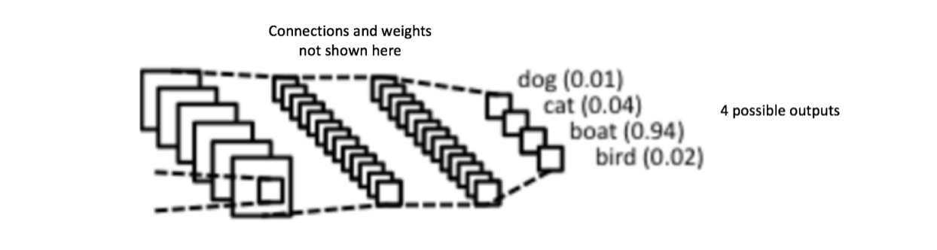
Fully connected layer to combine
Convolutional layers detected features
Pooling layers reduced complexity
Now we have a set of feature maps
Can combine them nonlinearly to classify

Slide 24
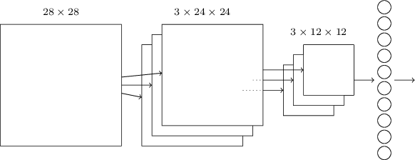
A full CNN
Slight modifications required for back propagation
Image taken from Michael Neilsen’s book “Neural Networks and Deep Learning”

Slide 25

CNN Architecture
Each convolutional unit has the same weight.

Slide 26
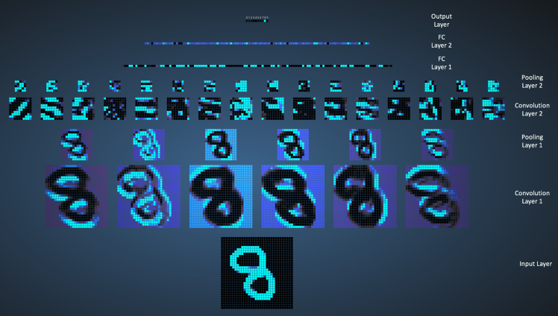
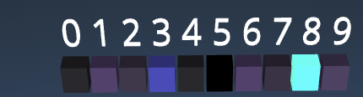
Visualizing a CNN
feature map1
feature map 6
https://adamharley.com/nn_vis/

Slide 27
Other Modifications: Inception
GoogleNet 2014: Introduced the Inception module that reduced parameters from 60 M to 4M (order of magnitude)
ResNet 2015: Residual network

Slide 28

Inception Network
Prior to Inception CNNs just tried stacking convolutions deeper and deeper to get better performance
Szegedy, Christian, et al. "Going deeper with convolutions." Proceedings of the IEEE conference on computer vision and pattern recognition. 2015.

Slide 29
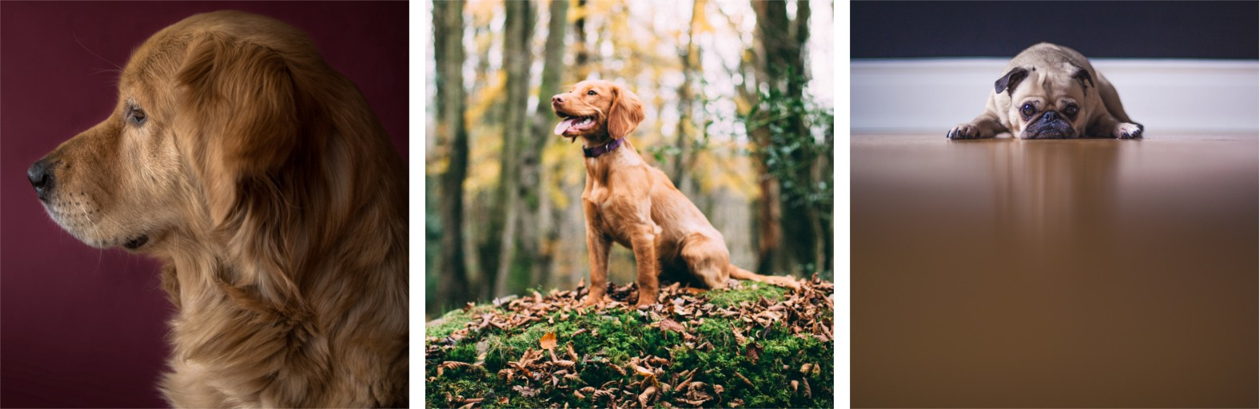
Resolution differences
Inception network realized that different features can come at different resolutions, which may need different sized convolutional filters

Slide 30
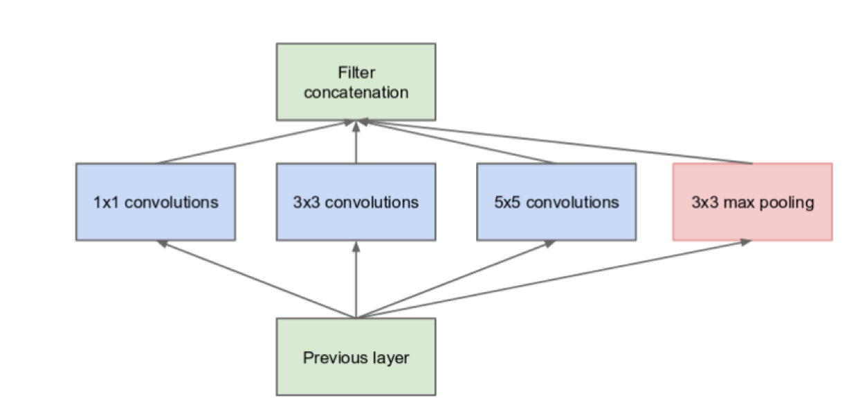
Basic Inception Module
Different resolutions of filters are the same level

Slide 31
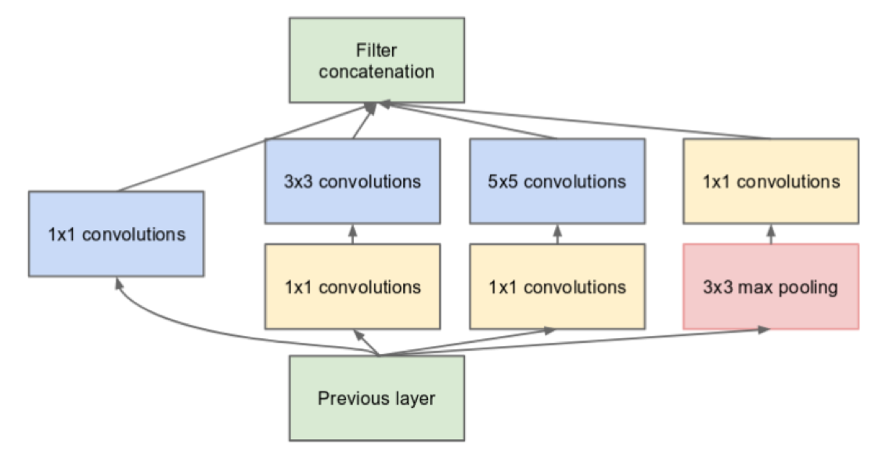
More convolutions, more expensive
Instead try to limit the number of input channels of a layer by doing 1x1 convolutions

Slide 32
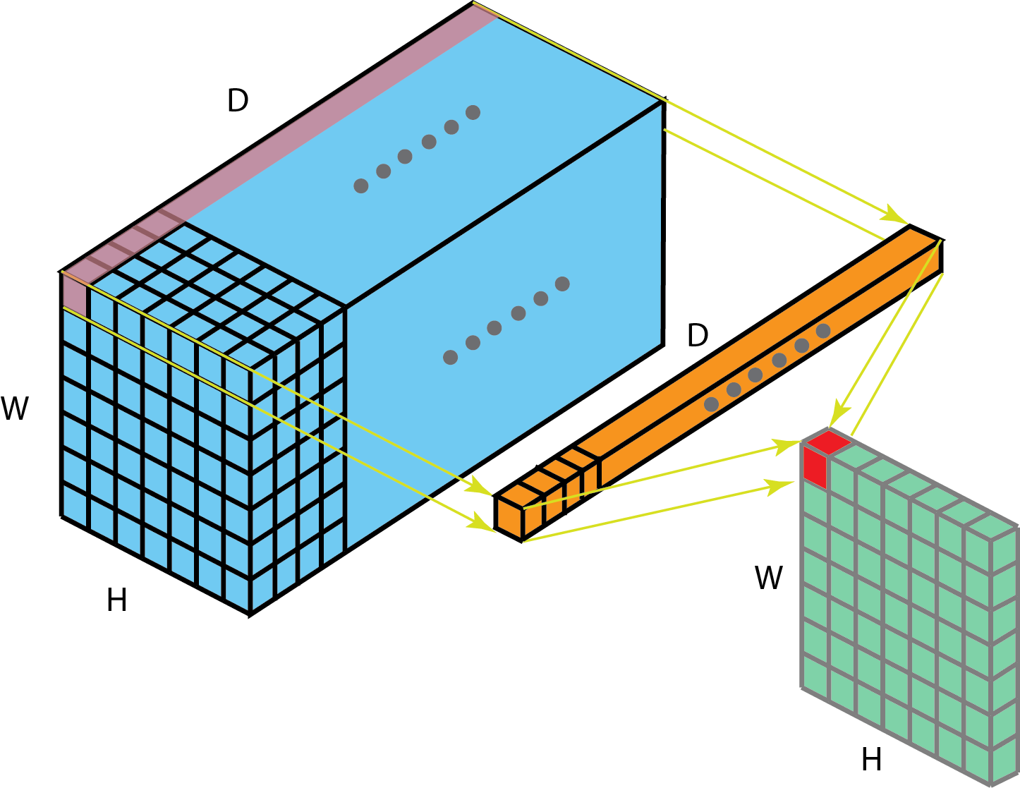
1x1 Convolutions for Dimension Reduction

Slide 33
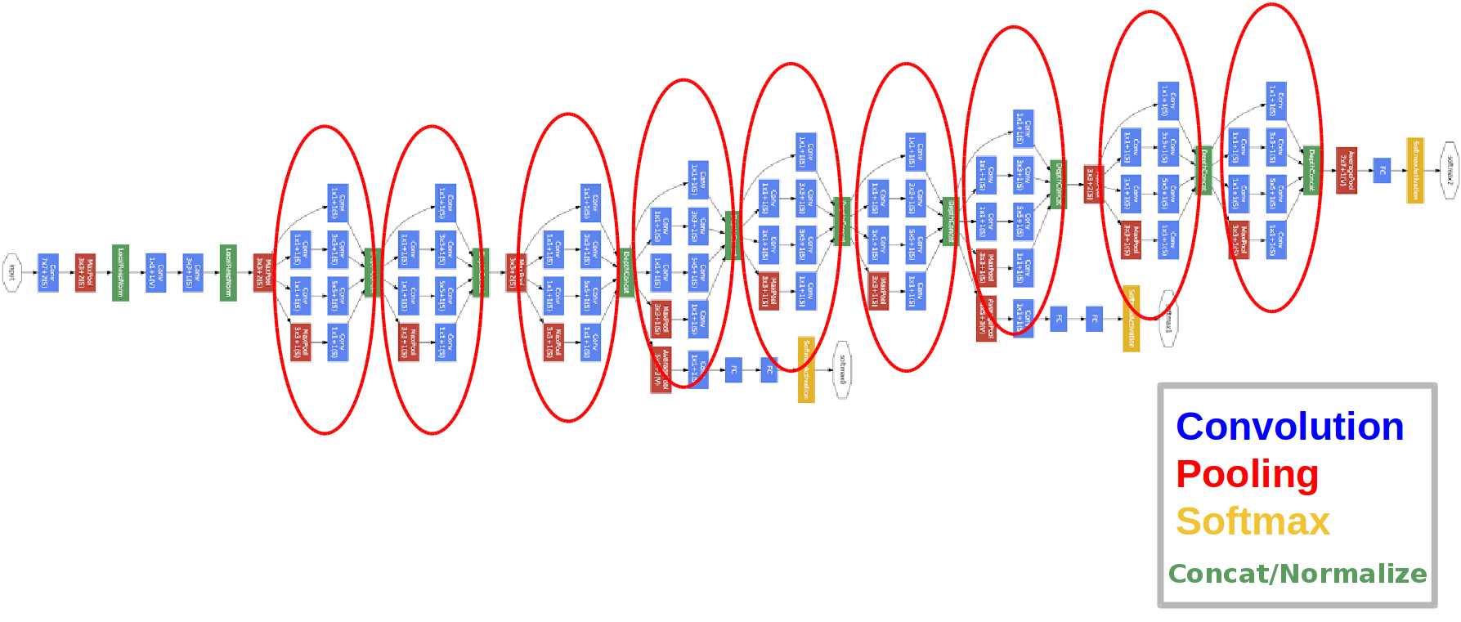
GoogleNet Architecture
Stacked Inception modules

Slide 34
ResNets
Inception network performed very well
However, making it even deeper did not improve performance
This motivated a new type of block
One that you can stack more and more of and get better performance with each additional block
Gradient flow through the network needs to be improved
Idea: use “skip connections”
He, Kaiming, et al. "Deep residual learning for image recognition." Proceedings of the IEEE conference on computer vision and pattern recognition. 2016.

Slide 35
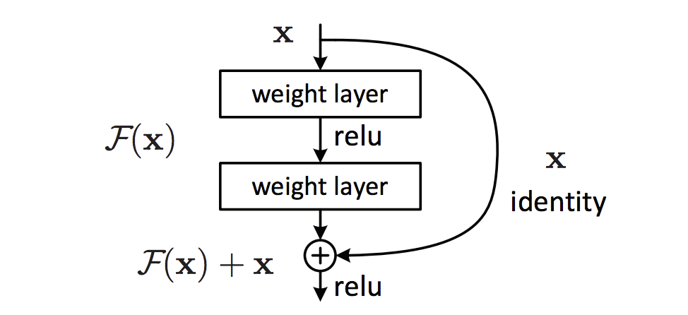
ResNets
The normal nonlinearity is learned and then added to the input
Instead of the activation being a = F(x) it is a = F(x) + x
He, Kaiming, et al. "Deep residual learning for image recognition." Proceedings of the IEEE conference on computer vision and pattern recognition. 2016.

Slide 36
ResNets
How does this address vanishing gradients?
He, Kaiming, et al. "Deep residual learning for image recognition." Proceedings of the IEEE conference on computer vision and pattern recognition. 2016.

Slide 37
ResNets
How does this address vanishing gradients?
No matter what the derivative of F is, the derivative going through the identity branch is constant
He, Kaiming, et al. "Deep residual learning for image recognition." Proceedings of the IEEE conference on computer vision and pattern recognition. 2016.

Slide 38
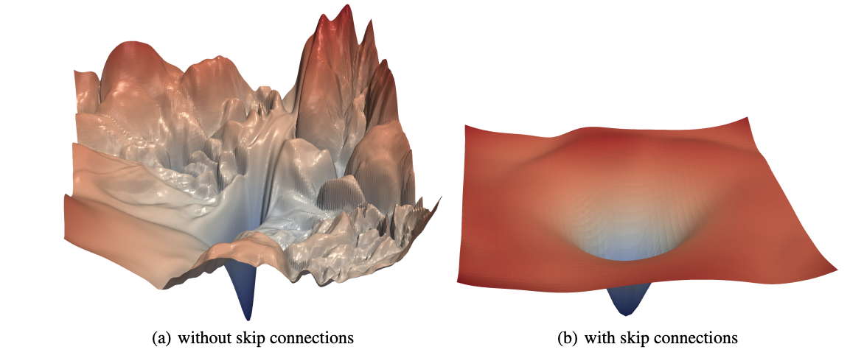
Effect of ResNET on Loss Landscape
[From Li et al. 2017]

Slide 39
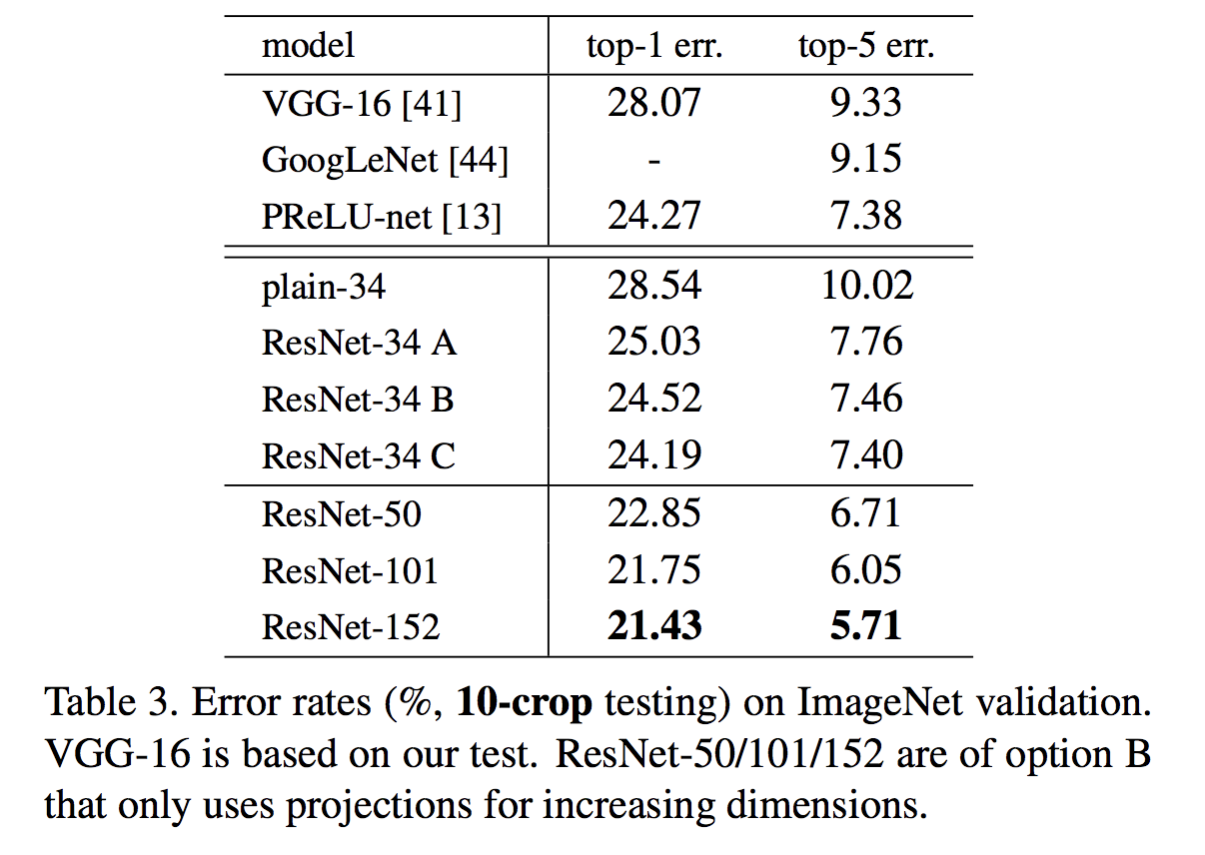
ResNets
This allows for training much deeper networks
But is each layer still as expressive as a regular layer? How does the network perform?
Various architectures of ResNets at just 34 layers already outperform Inception (GoogLeNet)
But now we can train even up to 152 layers!
More layers give better performance
He, Kaiming, et al. "Deep residual learning for image recognition." Proceedings of the IEEE conference on computer vision and pattern recognition. 2016.

Slide 40
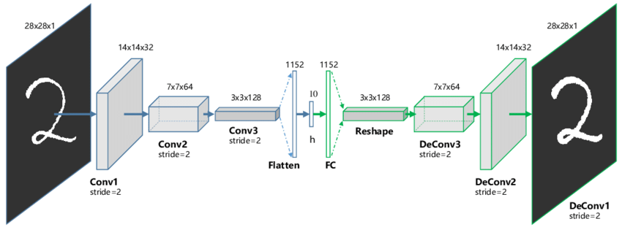
Convolutional Autoencoders
reconstructed
image
input image
latent representation
encoder
decoder

Slide 41
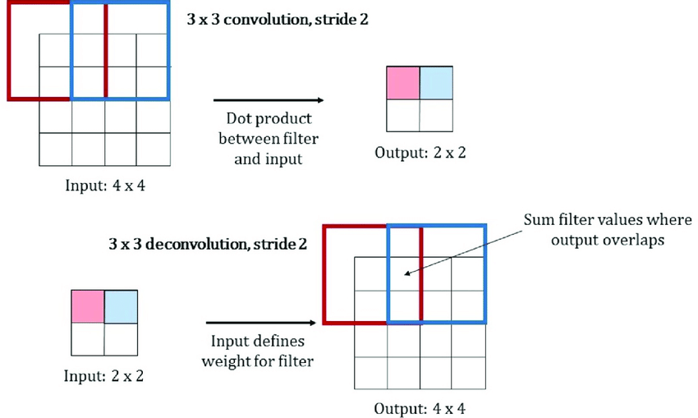
conv vs. deconv
, padding 1
conv
padding 1
deconv

Slide 42
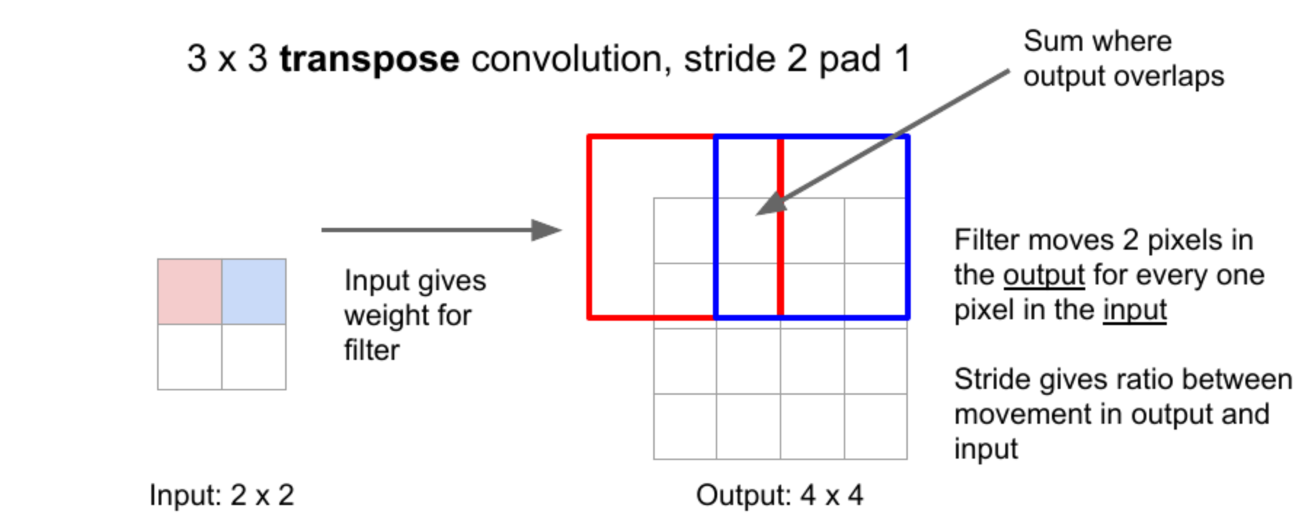
Decoding: Transposing Convolutions
Weight gives amount of input value being distributed to each of the output cells

Slide 43
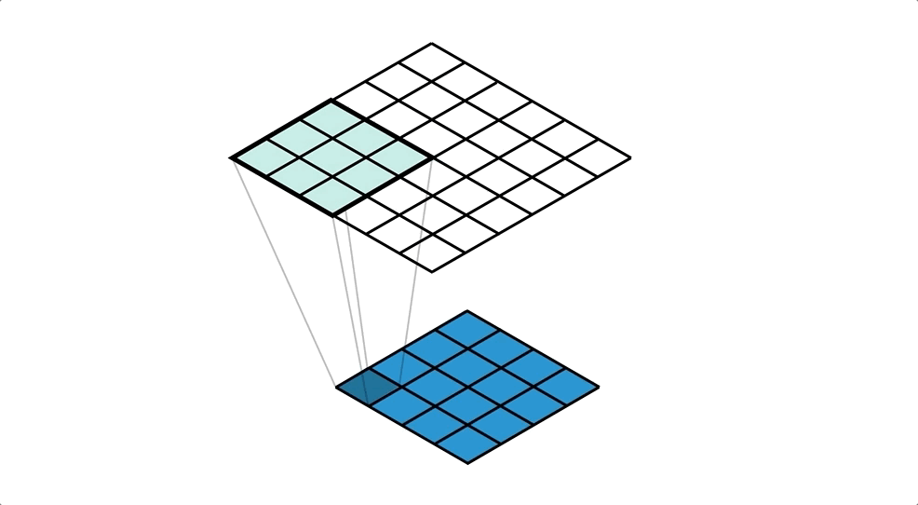
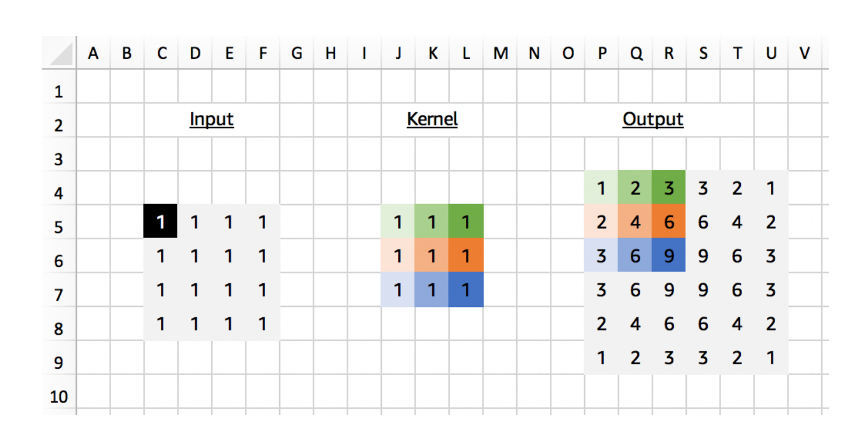
Decoding: Transposed Convolutions

Slide 44
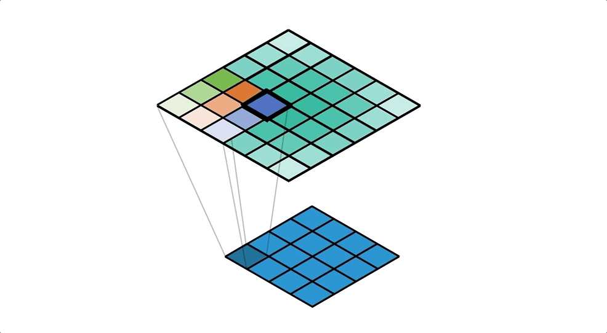
From the output cell perspective

Slide 45
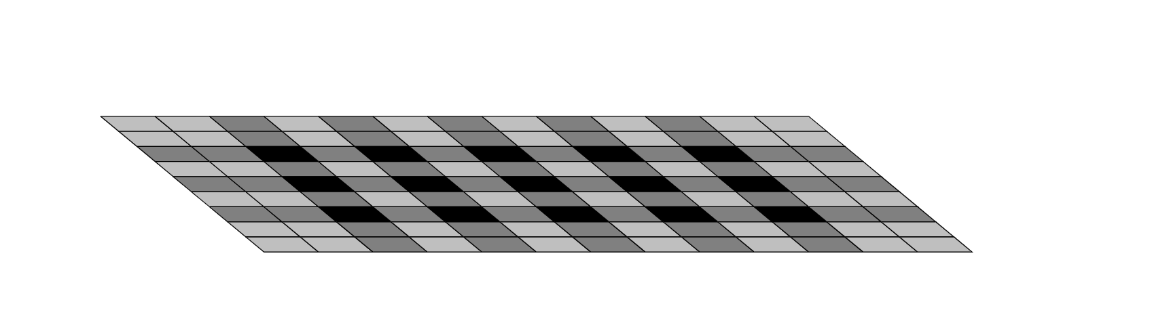
Checkerboard Artifacts

Slide 46
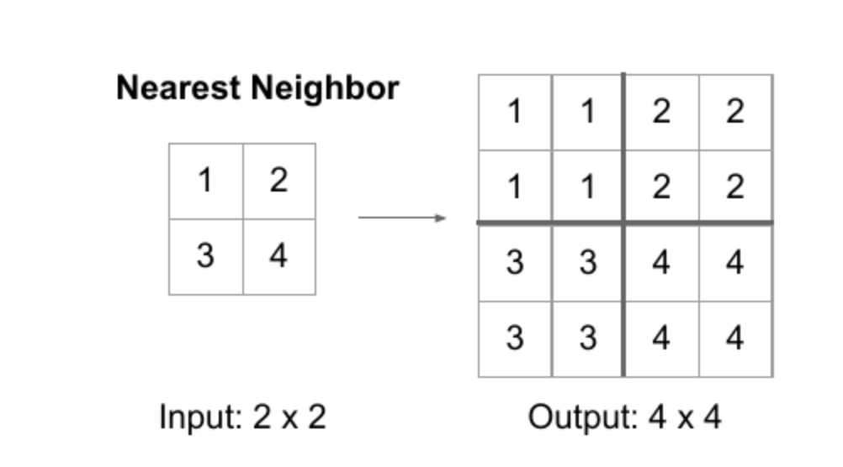
Upsampling

Slide 47
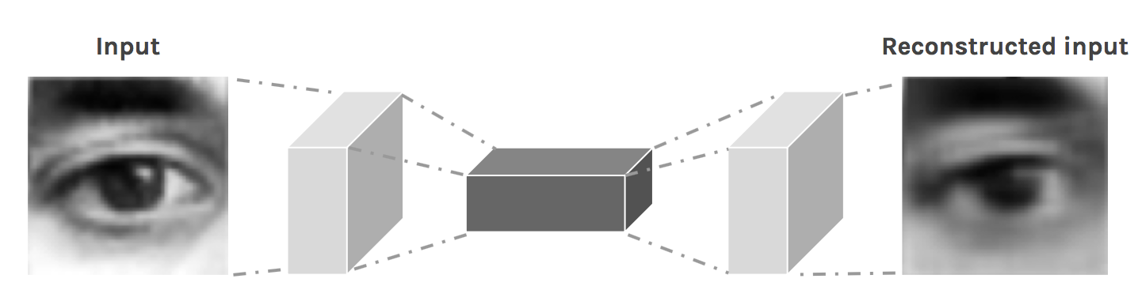
Blurry Reconstruction

Slide 48
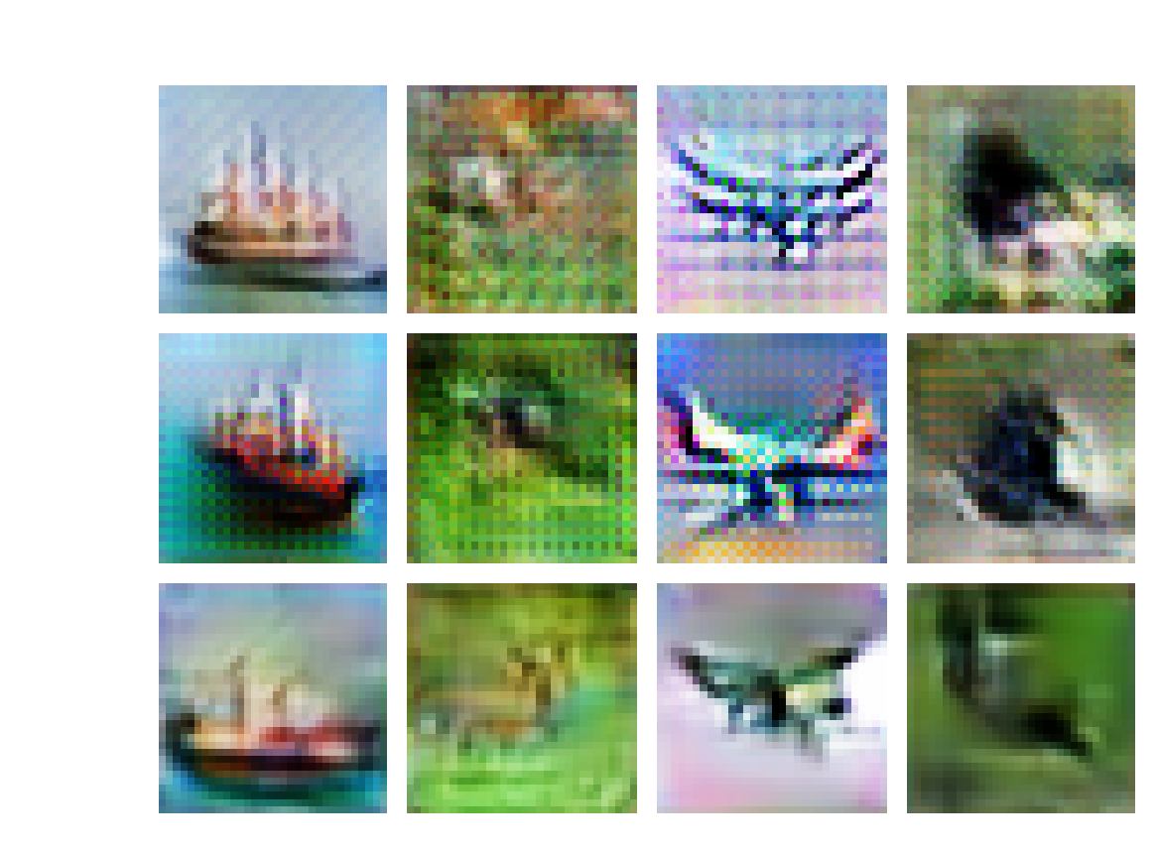
Transpose vs Upsampling

Slide 49
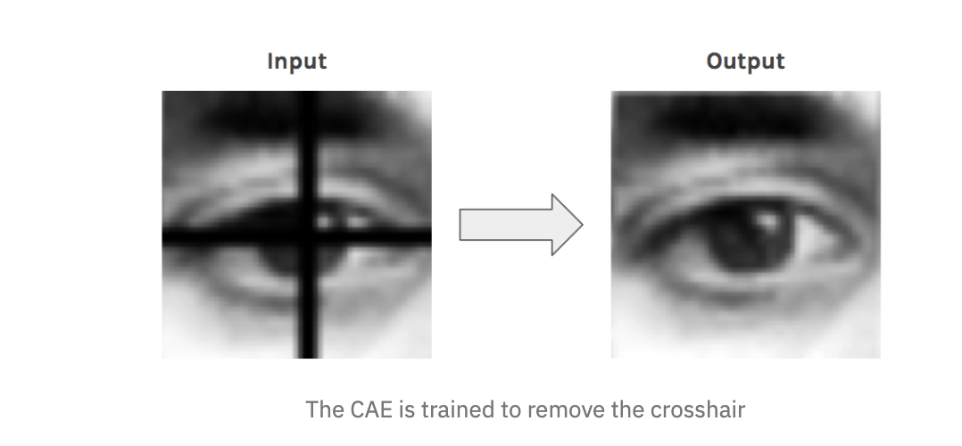
Uses: Denoising Images

Slide 50
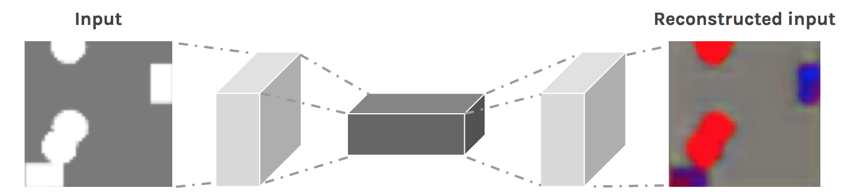
Image Colorization

Slide 51
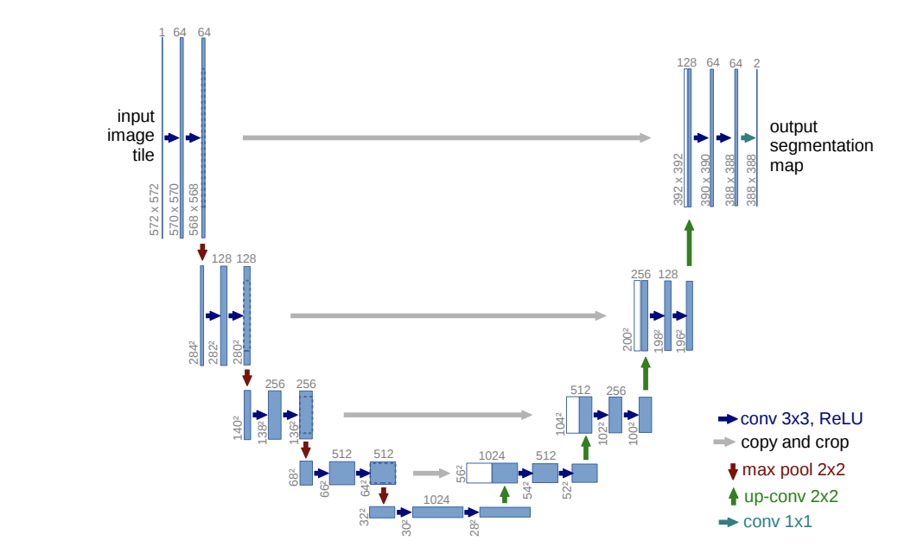
Image Segmentation: Unet
Decoder path: pooling layers replaced by upsampling layers along with skip connection

Slide 52
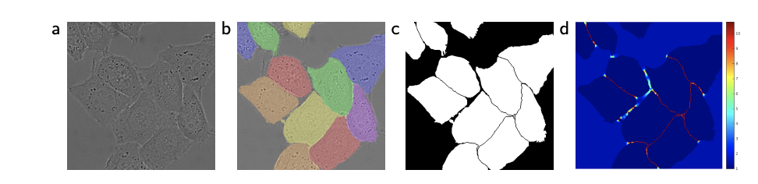
Segmentation of cells
Raw
Ground
Truth
Unet output
Training
Loss

Slide 53
Suggested Readings
Chapter 6 Nielsen
Szegedy et al. Going deeper with convolutions 2014
He et al. Deep Residual Learning for Image Recognition 2015
Ronneberger et al. Unet Architecture for Biomedical Image Segmentation
http://cs231n.github.io/convolutional-networks/
https://ujjwalkarn.me/2016/08/11/intuitive-explanation-convnets/
https://towardsdatascience.com/a-simple-guide-to-the-versions-of-the-inception-network-7fc52b863202

